Slide 1
Open Access and Open Science: making it happen
Katarzyna Gaca-Zając, PhD Eng
Customer Consultant for Central-Eastern Europe Elsevier

Slide 2
We don’t have all the answers, nor a fixed solution

Slide 3
How do we understand open science?
Open Science describes a way of working which makes research more inclusive, more collaborative and more transparent.
Elsevier partners with the research community to empower open science.
We believe open science can benefit research and society and drive research performance.
Elements of OS:
Open access
Open data
Open tools and platforms
Science and society
Research integrity and reproducibility
Open metrics

Slide 4
Global approaches to open science
European Commission’s 3 main policy goals for research and innovation are open innovation, open science and open to the world.
Open Science Policy Platform → recommendations based on 8 priorities:
FAIR Data
Publishing models for OA
Open Science Cloud
Alternative Metrics
Rewards
Research integrity
Citizen Science
Skills & Training

Slide 5
Drivers behind open science
Funder mandates on OA
Research journal
mandates on OA
Funder mandates on data archiving
Journal policies on Open Data
Journal policies
with regards to
Open Code
Source: The Lisbon Council

Slide 6
The Open Science Monitor
https://ec.europa.eu/info/research-and-innovation/strategy/goals-research-and-innovation-policy/open-science/open-science-monitor_en
Approach:
To deliver a monitoring system (for Europe) and (global) observatory for trends in Open Science;
To set up a global reference point for the Open Science community to interact with;
To determine the impacts of Open Science in the scientific domain;
To provide structured analysis of policy-relevant trends in Open Science.
Source: The Lisbon Council
As a subcontractor, Elsevier provides data from Scopus, Mendeley and Plum Analytics.

Slide 7
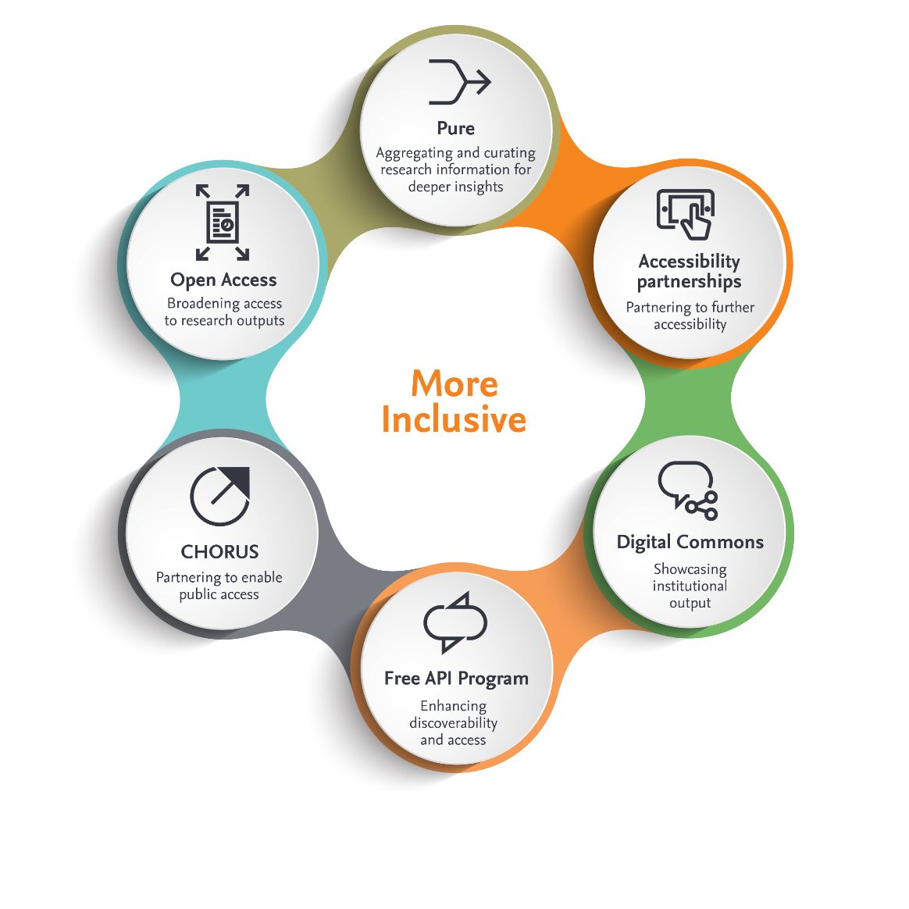
More inclusive

Slide 8
Snapshot of EU funding body policies
UKRI:
Gold – preferred, with funding available, CC BY
Green – 12/24 month embargo
Swedish Research Council, Sweden:
Gold – CC BY
Green – 6/12 month embargo
WT, UK:
Gold – preferred, with funding available, CC BY
Green – 6 month embargo and deposit in PMC
HEFCE, UK:
Gold – permitted, no specific license, no new funding
Green – 12/24 month embargo deposit AM in repository
NWO, NL:
Gold – CC BY
Green - immediate sharing of preprint
DFG Germany:
Gold - with capped/restricted funding available
Green -12 months embargo; deposit AM in public repository
EC, EU: Horizon 2020 funding program-
Gold - Permitted, pilot with OpenAIRE.
Green - 6 months embargo
(12 months for social sciences and humanities)
FWF, Austria:
Gold – CCBY, funding available
Green - 6 /12 month embargo
Notes:
Tutaj można dopowiedzieć o rodzajach umów, jakie podpisujemy.

Slide 9
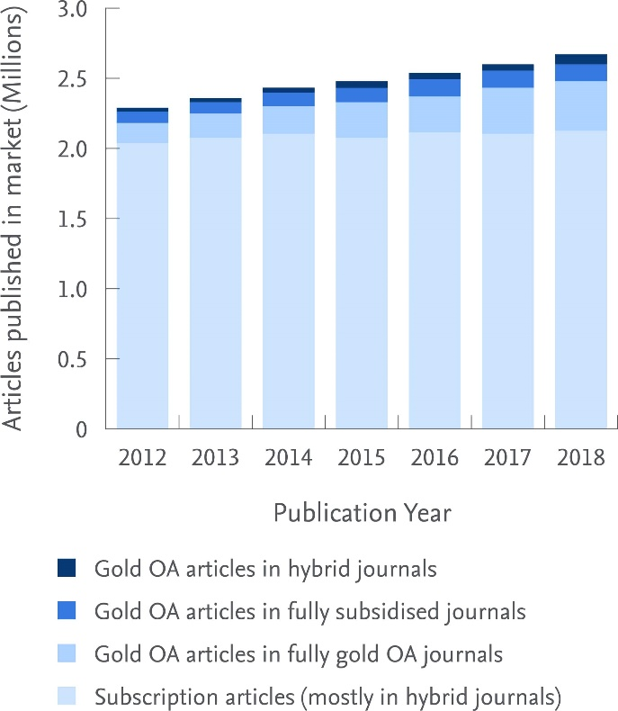
Total article growth by journal business model
In 2018 there were an estimated 2.1 million subscription and 0.5 million gold open access articles published worldwide.
Subscription content
80% share of total articles in 2018
Open access content
Gold open access articles published in full gold open access journals and hybrid journals made up 20% of the total articles in 2018
Elsevier perspective
In 2018, Elsevier published around 470,000 articles
This includes over 34,000 gold open access articles, a 26% increase on 2017

Slide 10
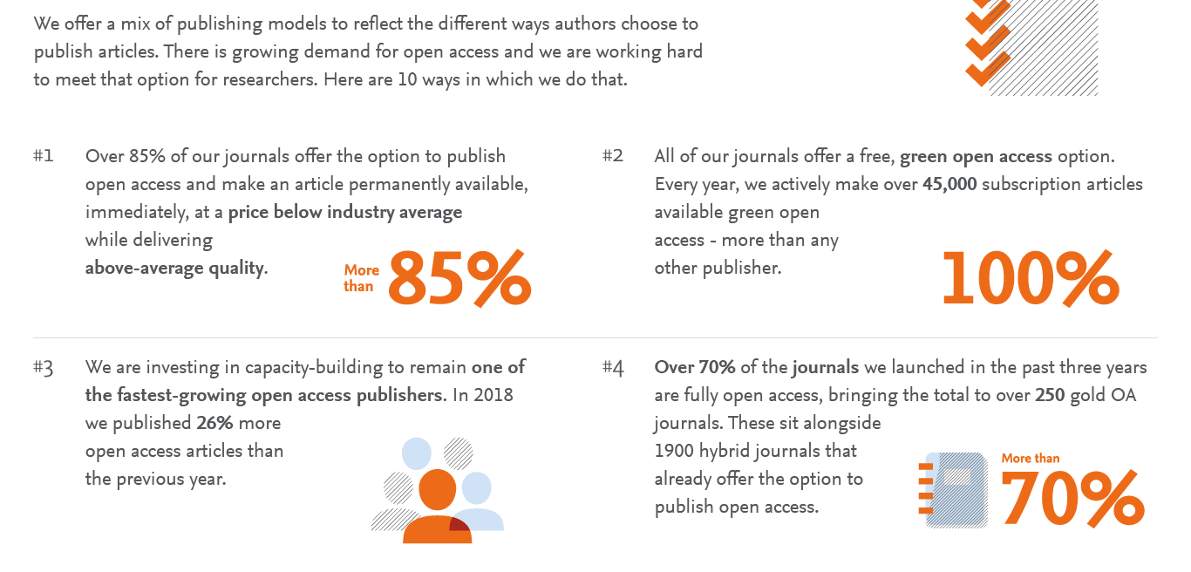
Elsevier and open access

Slide 11
Elsevier and open access

Slide 12
Elsevier and open access
Gold open access
Green open access
Published around 250 fully gold open access journals and over 1,900 hybrid journals
Published over 34,000 gold open access articles in 2018, a 26% increase on 2017
Choice of either a commercial (CC BY) or non-commercial (CC-BY-NC-ND) user license.
Article publishing charges (APCs) range from ~$150 to ~$6000 (US Dollars) excluding tax
Largest publisher enabler of green open access
All 2500+ journals provide a green open access option
Participate in CHORUS and support pilots with institutions and international funders
Free API program to fuel repositories
Share link service provides 50 days free access to recently published research
Open archives in 130 journals, including Cell Press titles after 12 months

Slide 13
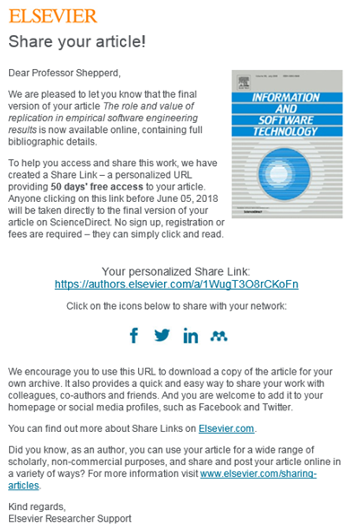
Share Links
Anyone clicking on the Share Link within a 50-day period will be taken directly to the article with no sign up or registration required.
Over 1.3 million articles were shared, generating over 10 million article views via Share Links
68.7% of links come from social media in 2018
Since Share Links became available to both corresponding and co-authors in August 2017, the number of authors receiving Share Links has increased by over 300%

Slide 15
Fueling IRs: free API program
Get metadata & abstracts
Show the final version
Keep users on your IR
Make manuscripts public
Search API can extract the metadata and abstracts of your affiliated authors to help populate your repository, enhance discoverability and create links or embed final version
Entitlements API** can ensure subscribed users see the final version and visitors can see the accepted manuscript hosted on your repository
Article Retrieval API embeds the final article in your repository so subscribers don’t leave your site to access the article
Hosting permissions API can retrieve embargo end dates so you can make manuscripts automatically available to the public after embargo
Did you know?
Scopus customers can also integrate Scopus APIs to retrieve metadata and abstracts across all publishers.
Please Note: **Minimum part of the program.
//dev.elsevier.com/tecdoc_sd_ir_integration.html
Notes:
Elsevier has developed APIs that IR managers can leverage to showcase their institutional output, increase public access and enhance the user experience in three ways:
1) Increase comprehensiveness of coverage of Elsevier-published content by authors from the institution;
2) Help users to access the best available version; and
3) Keep users in the IR, even when reading final articles.
Read more: https://www.elsevier.com/connect/using-the-sciencedirect-api-to-increase-visibility-and-access-to-research-articles

Slide 16
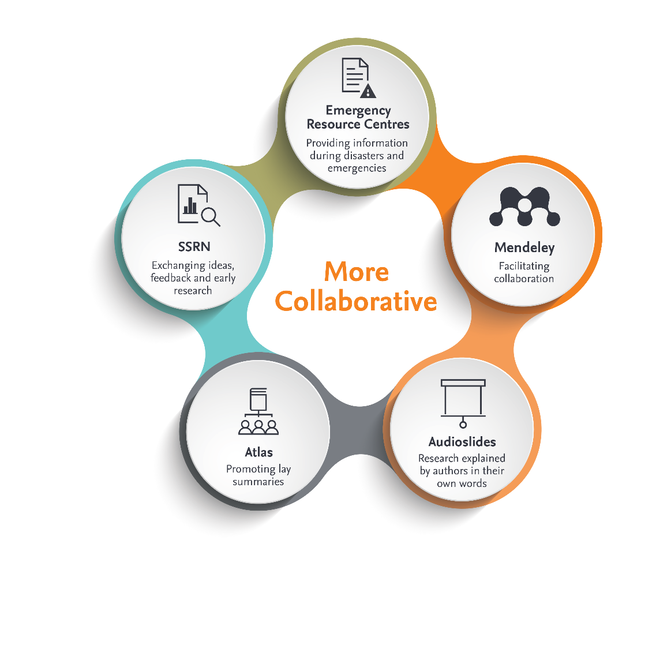
More collaborative

Slide 17
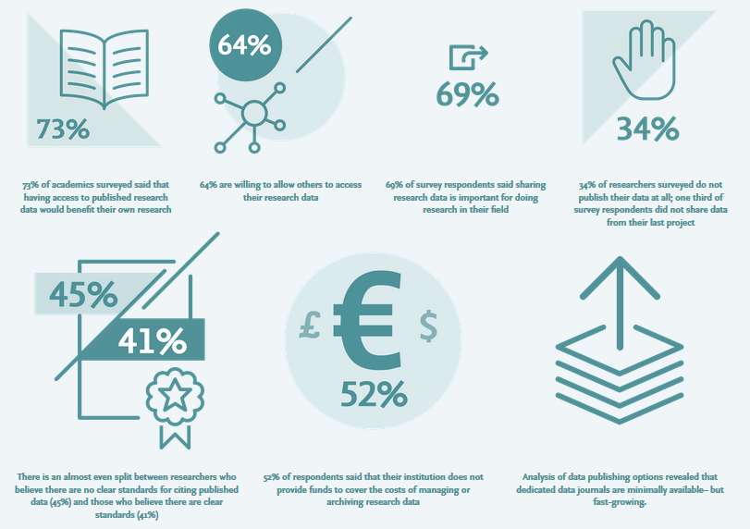
Notes:
The Open Data report is a result of a year-long, co-conducted study between Elsevier and the Centre for Science and Technology Studies (CWTS), part of Leiden University, the Netherlands. The study is based on a complementary methods approach consisting of a quantitative analysis of bibliometric and publication data, a global survey of 1,200 researchers and three case studies including in-depth interviews with key individuals involved in data collection, analysis and deposition in the fields of soil science, human genetics and digital humanities.

Slide 18
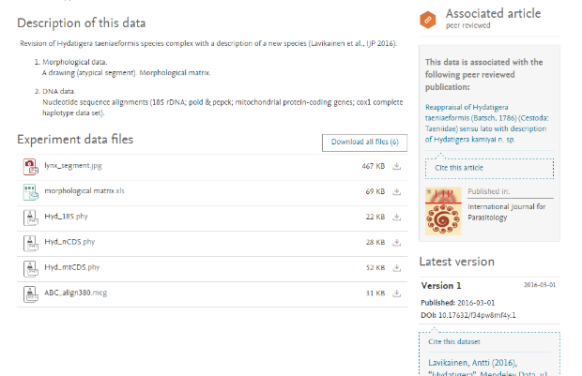
Storing research data & facilitating cooperation
Submitting authors can store research data in Mendeley Data repository and link this to their article on ScienceDirect.
Open access, free-to-use repository
Indexes over 10 million datasets from domain-specific and cross-domain repositories
Hosts all formats (raw, processed data, tables, code and software)
10GB free storage and CC0 license option
Assigns data DOI to make it independently citable
Partnership with DANS for long term storage and preservation
https://data.mendeley.com/

Slide 19
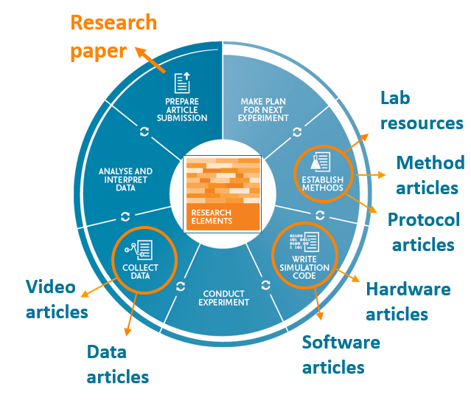
Publishing data articles
Offer researchers an easy channel to publish their research output, receive credit, and make research objects discoverable
Dedicated sections in regular journals
Specialized, fast and transparent peer-review process
Co-submission service via regular journals for data articles
Primarily Open Access, APCs of ~500 USD
Because no matter what field of research you are in,
data, methods and software always matter

Slide 20
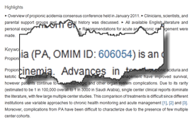
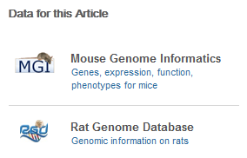
Linking to external data repositories
Free Data-linking tool provides one click access to relevant stored data sets
50+ leading domain specific data repositories
Linking enabled by in-article accession numbers, data DOI’s, or data banners
Database banners shown next to the article on ScienceDirect
Linking through in-article data accession numbers
See http://www.elsevier.com/databaselinking

Slide 21
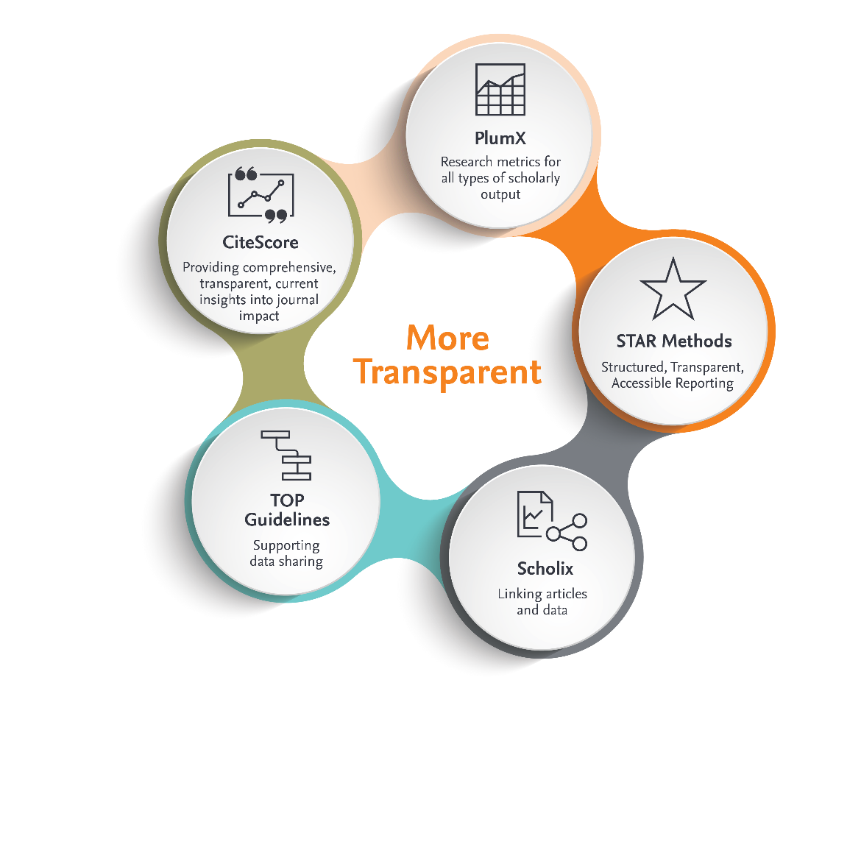
More transparent

Slide 22
Open peer review reports
Pilot in 5 journals to experiment with publishing peer review reports as publicly available research outputs with their own DOI.
Editors
Reviewers
Authors
Forward look
Extend to other interested journals and provide more data about the peer review process on ScienceDirect.
70% of those surveyed believe that reports are more in depth and constructive i.e. improved and more useful to authors, as a result of being made open
Some concern it may make it harder to find reviewers.
Like the ability to get recognition
Over 95% said publishing review reports didn’t influence their recommendation nor would it influence them accepting further review invites for the journal.
Generally positive about having open peer review reports next to their article
Little impact on their journal choice, indeed slightly more likely to choose a journal offering this.
Notes:
Decision to opt-out lies with the editor. Authors are informed on submission to the journal that this could happen, no option to opt-out. Reviewer also informed on invitation of editor that review will be published openly, but that they can remain anonymous if published. Reports assigned a DOI and published openly, but are not assigned any reuse license (unless gold OA journal). Pilot included two open access journals, three hybrid journals.
Elsevier uses single-blind and double-blind review process
Forward look data e.g, such as #of reviews per article upon acceptance

Slide 23
Comprehensive Journal Data Guidelines
https://www.elsevier.com/authors/author-services/research-data/data-guidelines
https://cos.io/our-services/top-guidelines/
Notes:
More on Elsevier and the TOP guidelines:
https://www.elsevier.com/connect/elsevier-supports-top-guidelines-in-ongoing-efforts-to-ensure-research-quality-and-transparency

Slide 24
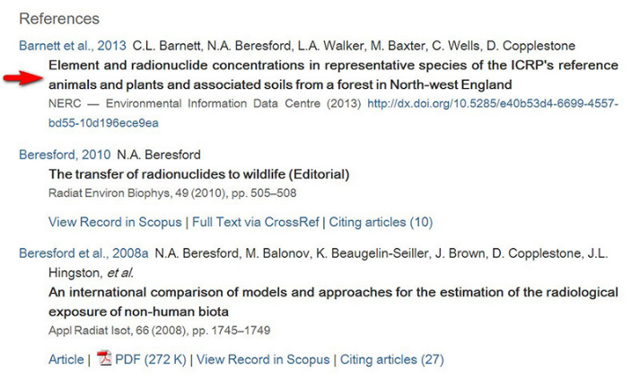
Implemented data citations
Authors are encouraged to cite datasets
Used to access a direct link to stored datasets and encourage data sharing
Implemented the FORCE 11 data citation principles for all journals
Data references contain different elements than article references
Require new fields to be added
Tags to distinguish between data and article references

Slide 25
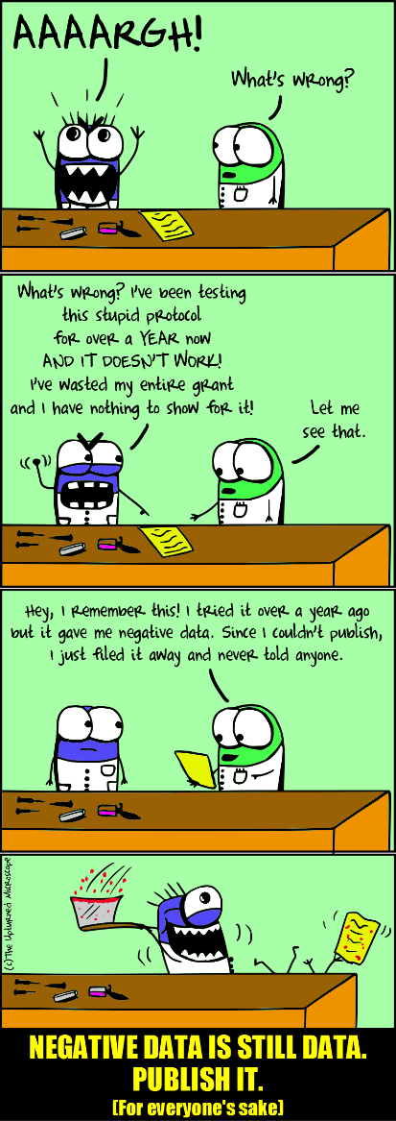
Enhanced Reporting
WHO calling for main findings submitted for publication - including negative findings
Launch of journal New Negatives in Plant Sciences
Scientists need a clear framework to submit data for review and publication.
Launch journals Data in Brief and Genomics Data
AllTrials calls for all clinical trials to be registered with full methods and summary results reported
Launch of journal Contemporary Clinical Trials Communications
Participation in new Crossref pilot to link published reports of clinical trials to the registered study
Notes:
https://www.elsevier.com/about/press-releases/research-and-journals/elsevier-journals-to-link-published-reports-of-clinical-trials-to-the-registered-study
https://www.elsevier.com/connect/new-journal-will-publish-results-from-all-scientifically-sound-clinical-trials
http://www.alltrials.net/news/elsevier-joins-alltrials/
Illustration from: https://theupturnedmicroscope.com/comic/negative-data/ by Nik Papageorgiou

Slide 26
Ačiū už dėmesį
Questions or comments?
k.gaca-zajac@elsevier.com

